Slide 1


HEALTH CARE MONITORING System USING iOt
Konkan Gyanpeeth College of Engineering, Karjat
Department of Information Technology
Group No. 10
Project Group Members | Roll no
Bhushan N. Koli | 32
Twinkle Mahajan | 38
Keval Rothe | 45
Krishna Khilare | 30
Guide
Prof. Poonam B. Lad
Project Coordinator
Prof. Anup S. Kunte

Slide 2
content
Abstract
Introduction
Literature survey
Components and Information
Objectives
WorkFlow
Block Diagram
Future Scope
Problem statement
Conclusion
References

Slide 3
Abstarct
The near about 20% of the total population loses their lives due to interrupted health monitoring system i.e. in most of the hospitals, doctor visits patients either in morning shift or in evening shift or in both shifts. What happens if patient's health becomes critical in between that interval or when a doctor is not available with a patient. The answer is; a patient may lose her\his life. So to avoid this critical situation; we are proposing a smart embedded system device which monitors patients health continuously. This system monitors patients heart rate, body temperature and if any of the above parameters goes beyond the threshold value, this smart device informs doctors or care taker and ask for corrective actions to save patients life.

Slide 4
Introduction
An Embedded system is a single purpose system which is dedicated to unique monitoring system.
These sensor networks are playing a vital role in the present world. The updates of the patient health can be seen in three ways viz. one is on LCD screen, the second is by an alert message and the last is stored in cloud. To know the health parameters we used some sensor instruments.
They are temperature sensor, Humidity sensor and heart beat sensor. By using all these parameters we can watch the condition of a patient digitally in LCD.
The sensor network protocols, algorithms and operations show self-regulating capabilities. The One of the most important constraints of the sensor nodes is low power consumption. The main elements in this work are sensor elements.

Slide 5
Literature survey
SR NO. | Research paper Name | Requirements of project in Research paper | Objectives
1. | Analysis is on Healthcare System Using IOT, IJTSRD Volume:3 |Issue:4 |May-June2019 Author: Nitin P. Jain Preeti N. Jain Trupti P. Agarkar Navi Mumbai, India | Hardware: 1.Temperature Sensor(L25) 2.ESP8266 (wifi Module) 3. Heartbeat Sensor Software: 1.Arduino IDE 2.Thinger.io cloud | The basic aim of this health care monitoring system is to get the online data on time about the patient and interpret these data by using Iot Platform.
2 | Analysis of Different IOT based Healthcare Monitoring System ,IJITEE ISSN:2278-3075,Volume -8,Issue6S2,April 2019 Author: Maradugu Anil Kumar M.Tech, Embedded Systems Vignan's University, Vadlamudi, India | Hardware: 1.Heartbeat sensor 2.Temperature sensor 3.Body sensor 4.Ardino Uno 5.Power supply Software: Arduino IDE | The basic Aim of this Health Care monitoring system is the Iot system we can analyze and provide information to a patient to anytime in any location.

Slide 6
Resources Gathered
Hardware components:-
Software components:-
Arduino IDE
Google Firebase
Thingspeak
Wifi ModuleESP8266
Heartbeat sensor
LM-35 Temparature sensor
Arduino uno
LCD
DHT22 Room and Humidity Sensor
Wires and Breadboard

Slide 7
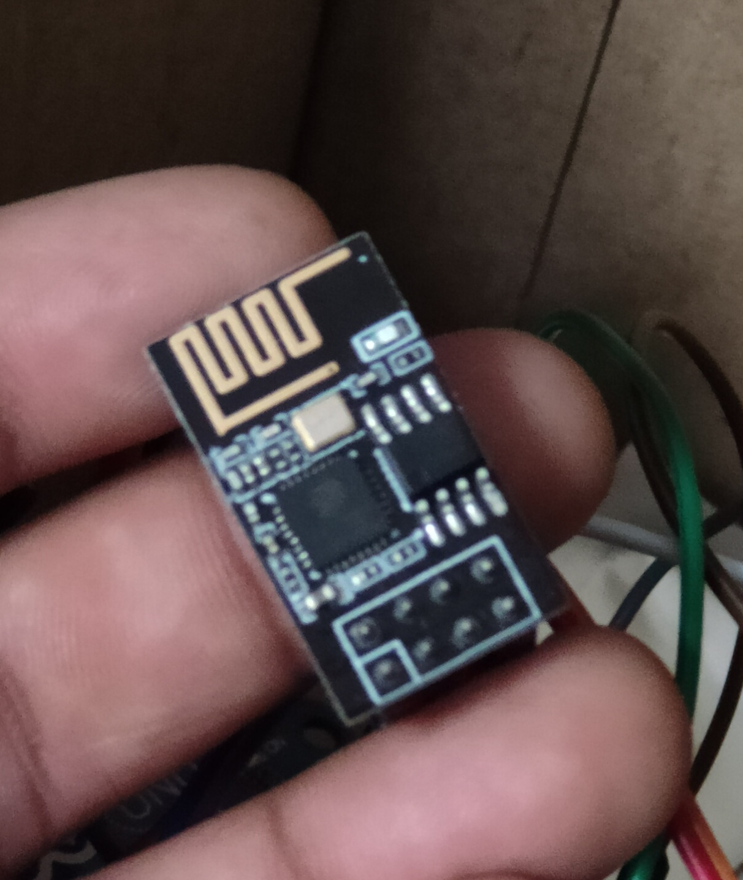
Wifi Module
ESP8266 WiFi Module is a self contained SOC with integrated TCP/IP protocol stack that can give any microcontroller access to your WiFi network.
The ESP8266 is capable of either hosting an application or offloading all WiFi networking functions from another application processor.

Slide 8
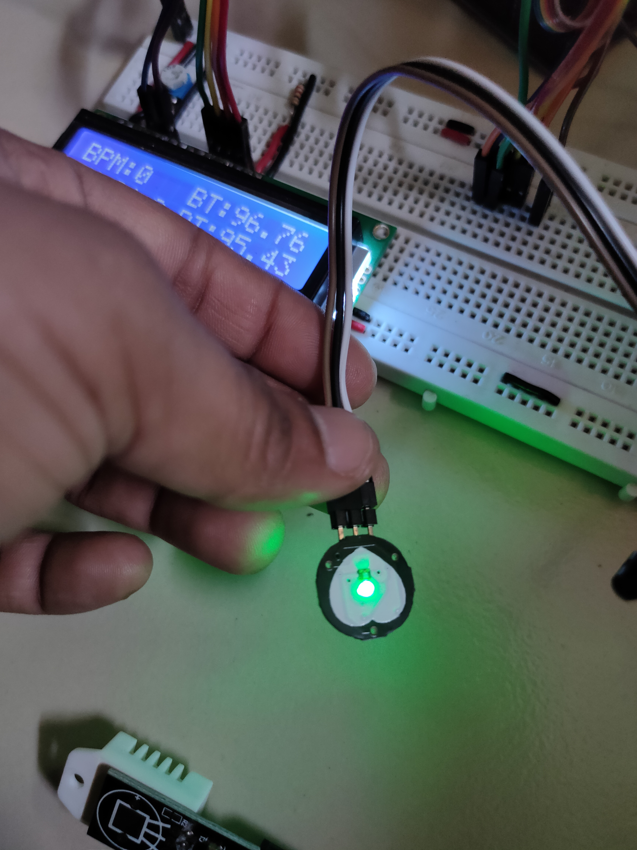
HEartbeat sensor
Heartbeat Sensor is an electronic device that is used to measure the heart rate i.e. speed of the heartbeat. It is also known as Pulse Meter.
A very commonly available Sensor which can sometimes help you a lot in monitoring your health in day to day life.

Slide 9
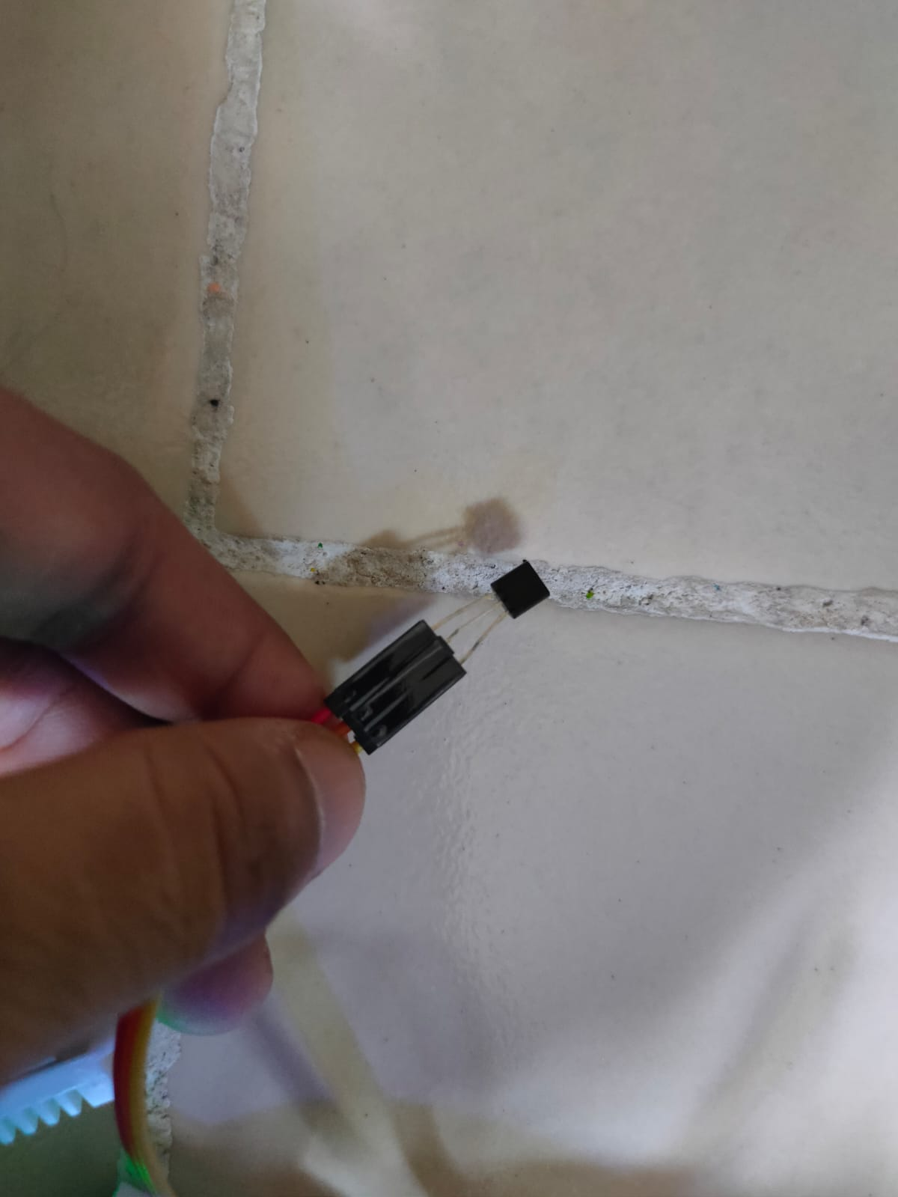
LM-35 Temparature sensor
The LM35 Linear Temperature Sensor module is useful in detecting ambient air temperature and Body Temperature. Sensitivity is 10mV per degree Celsius. The output voltage is proportional to the temperature. LM35 is a precision IC temperature sensor with its output proportional to the temperature (in °C).
We had used this sensor to check the Body Temperature, helping us to monitor it accordingly for or his/her speedy recovery.

Slide 10
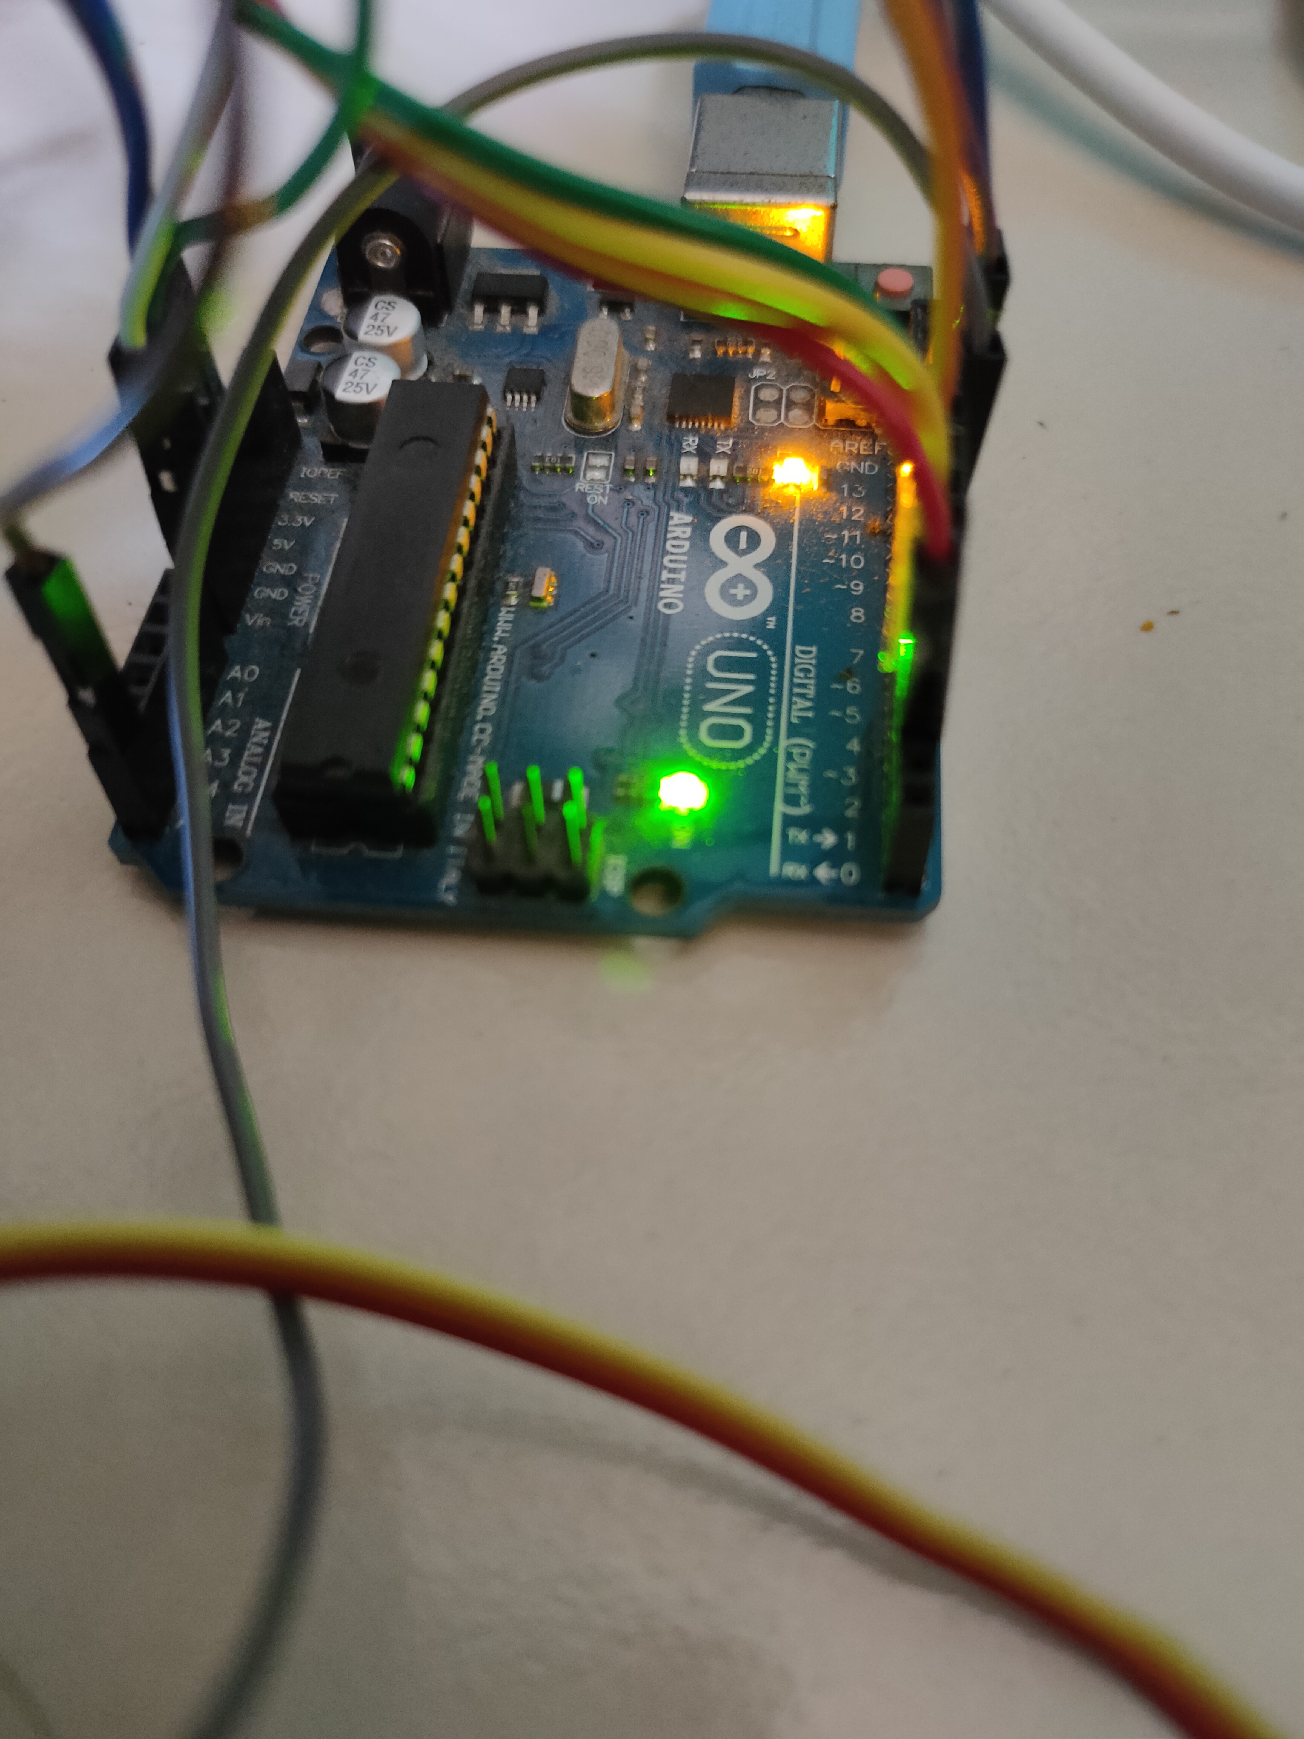
Arduino UNO
The Arduino Uno is one of the most common Arduino boards available, and it has some user-friendly features, including large 2.54mm pitched sockets for connecting to external devices, an onboard LED, and a large USB B connector for connecting to a PC.
We have already connected all the sensors to Breadboard, which helps Aurdino UNO to collect the readings per second and then send it to our alotted Web Portal.

Slide 11
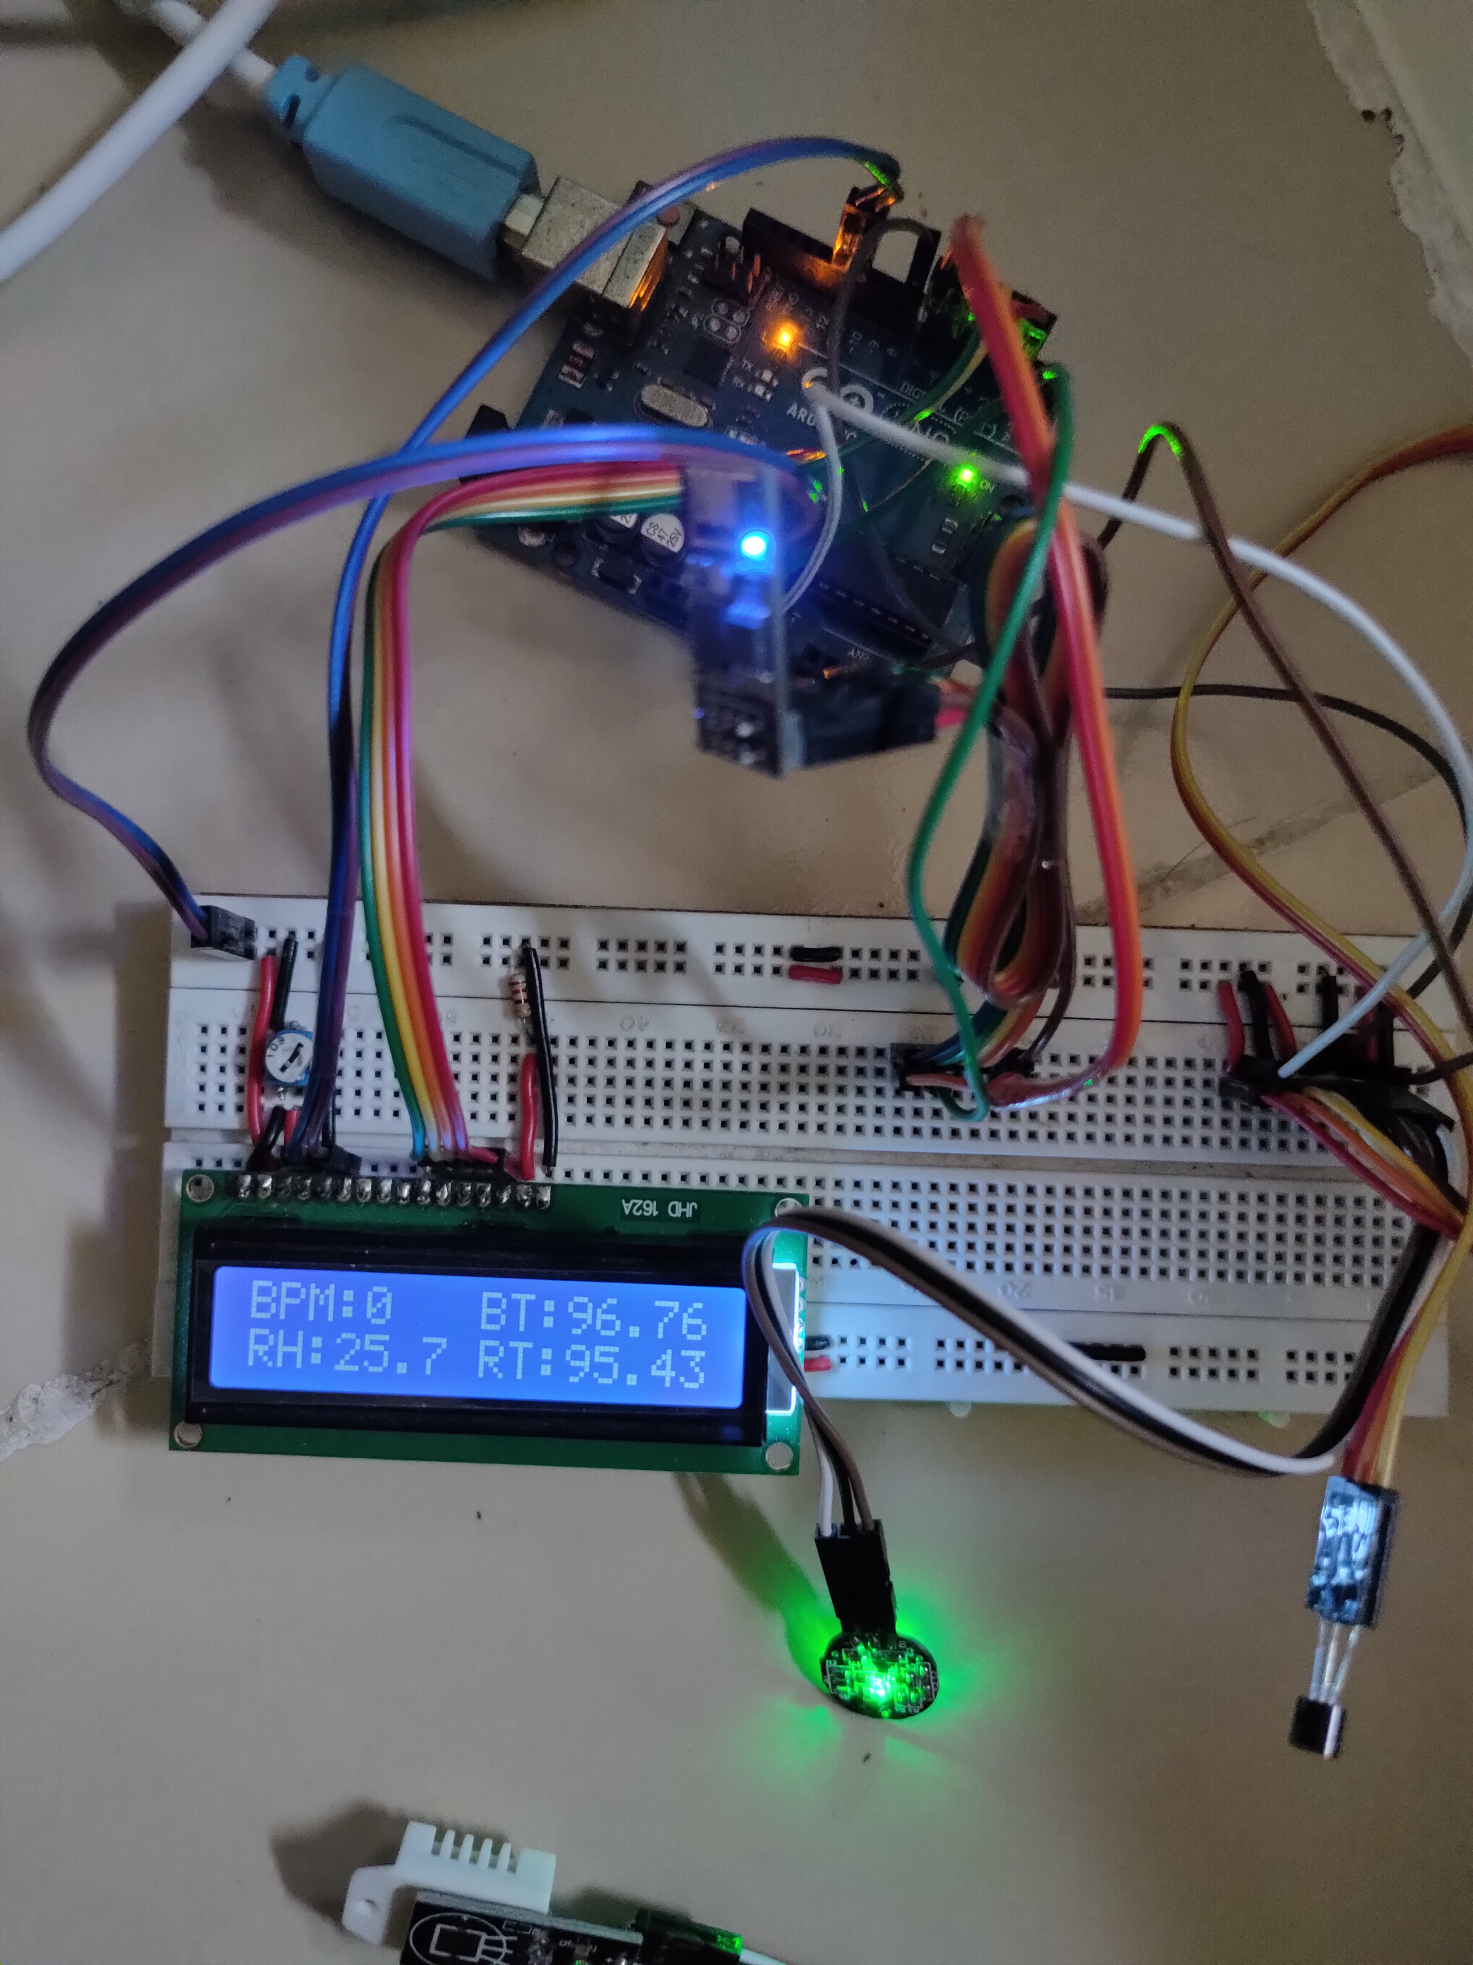
LCD1602 Screen
We can easily interface a liquid crystal display (LCD) with an Arduino to provide a user interface.
Liquid crystal displays (LCDs) are a commonly used to display data in devices such as calculators, microwave ovens, and many other electronic devices.

Slide 12
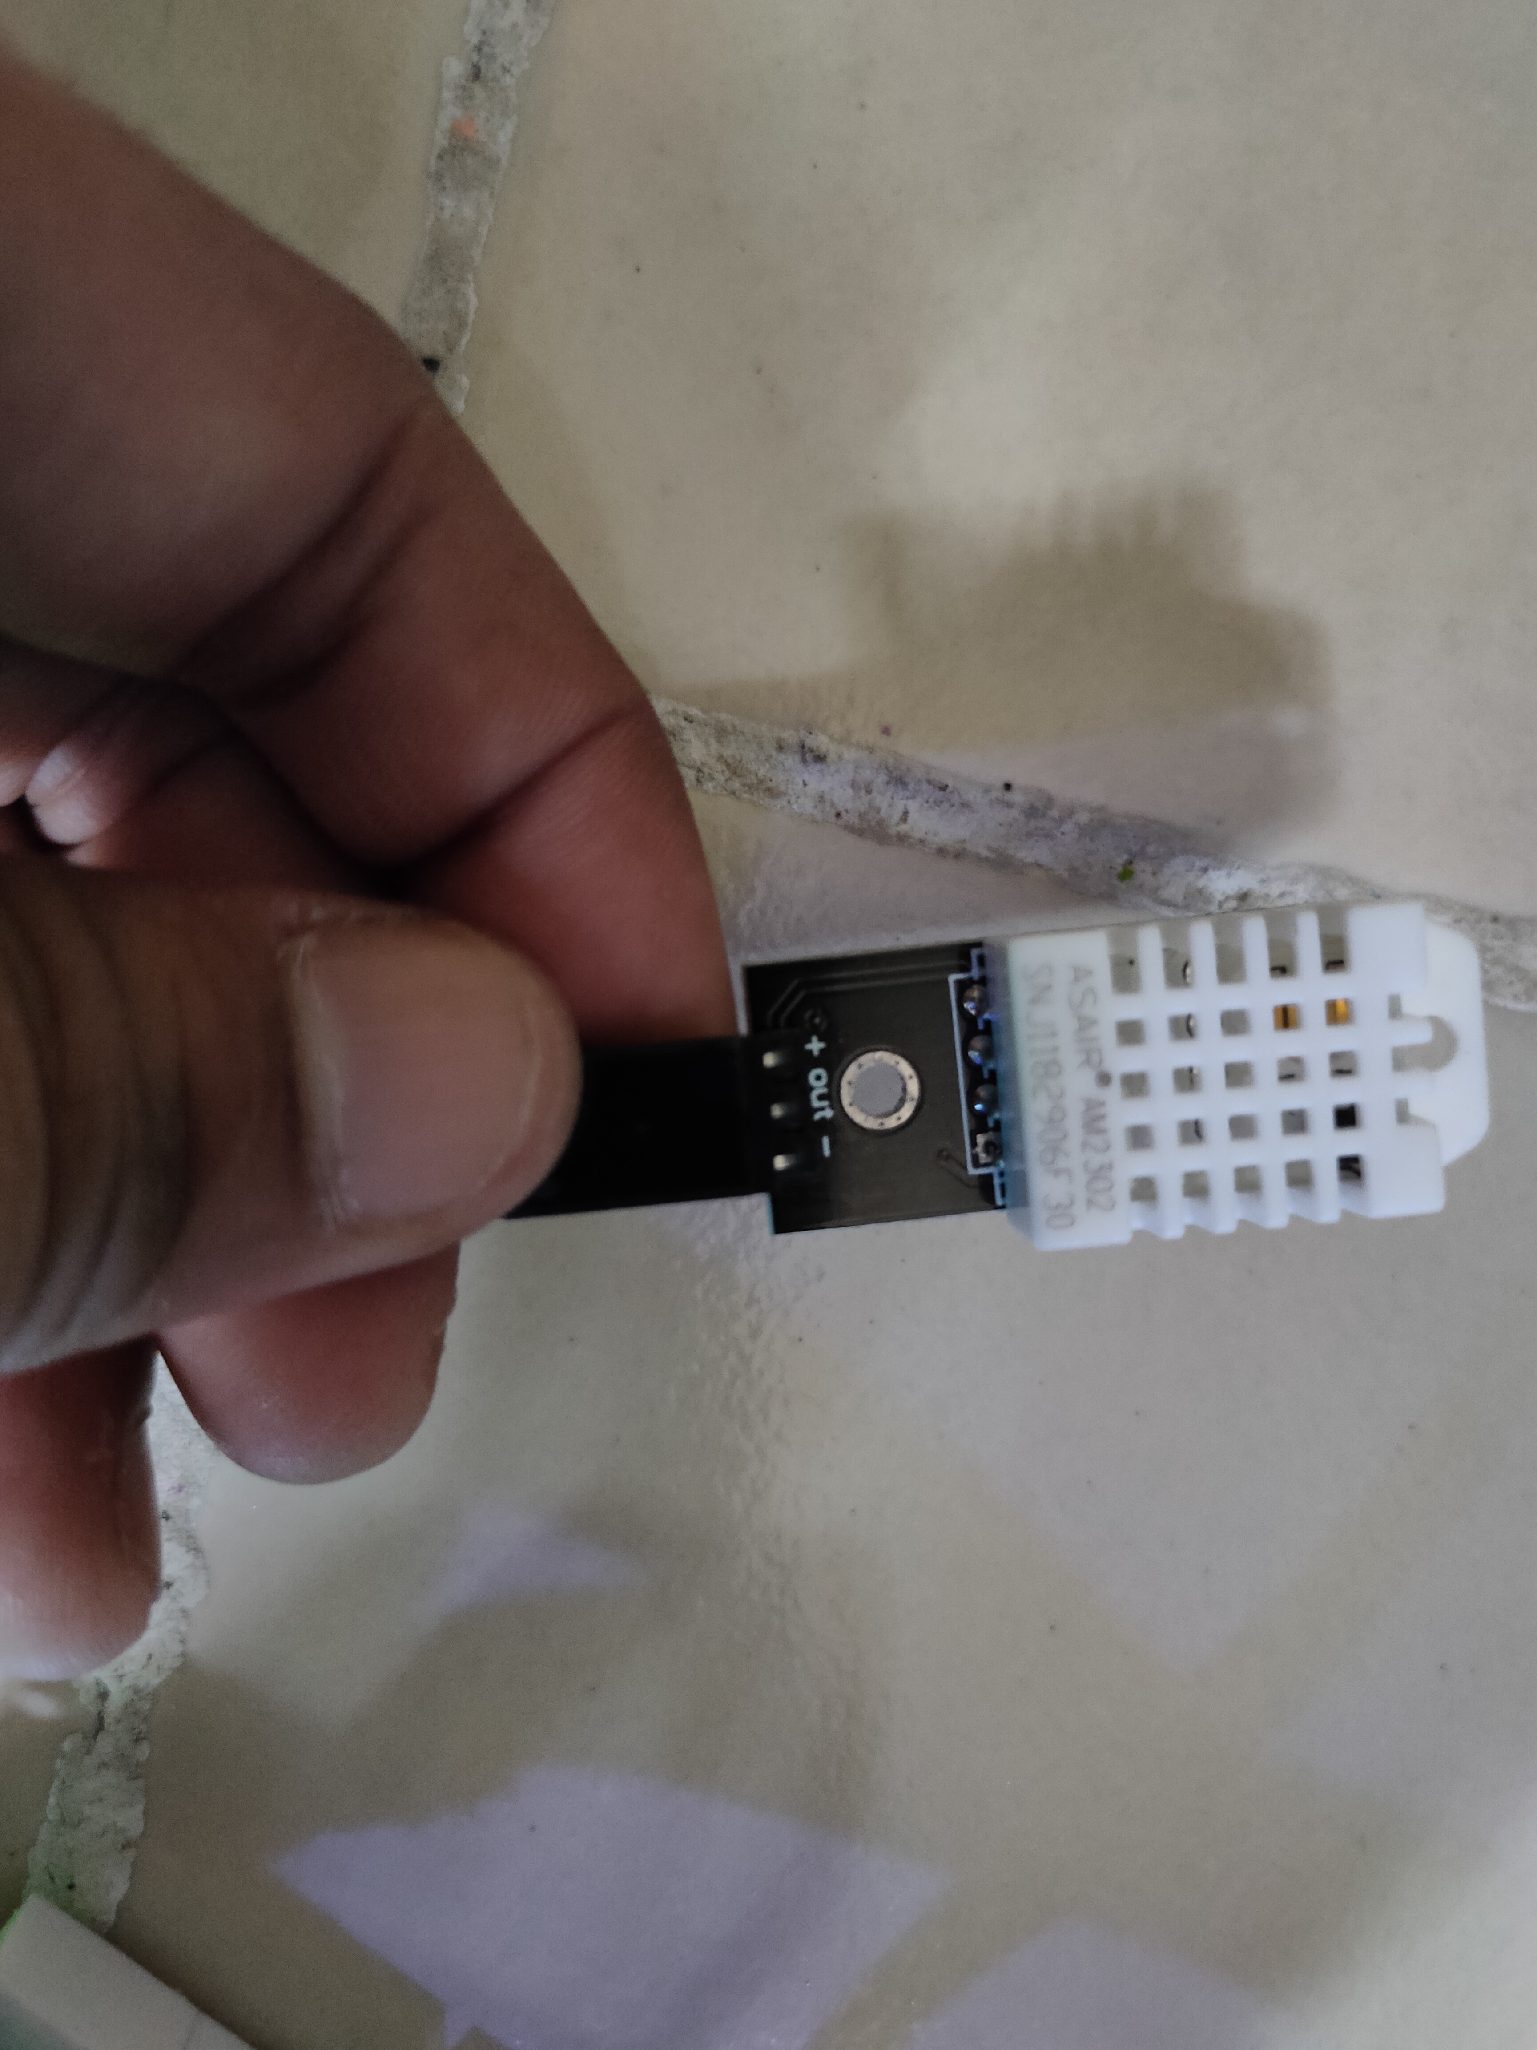
DHT22 Room and Humidity Sensor
It is made up of two components: a capacitive humidity sensor and a thermistor, which measures temperature.
We had used this Sensor to collect values of Humidity and Room Temperature.

Slide 13
Wires and BreadBoard
Wires and Bread board are the base of every project and helps to perform the Project accordingly.

Slide 14
Objectives
The aim of Health care Monitoring System is to give warning of early or dangerous deterioration and to achieve this by obtaining an optimal compromise involving many design factors, clinical, engineering and economic.
To help the Rural Area people get used with this Smart Application in their Android Phones.
To Design a HealthCare Monitoring System (RPHMS) which has heartbeat detection system, temperature detection system, a humidity detection system.
An attempt at designing a Healthcare Monitoring System made with locally available components.

Slide 15
Workflow
The Arduino Uno will Read data from pulse Rate sensor ,Temperature Sensor and Humidity Sensor and send it to the smart healthcare portal where real time data will be displayed in Graphical Representation.
Historical Data is also stored and can be accessed using History page . The data sent from Arduino will be Checked against optimal body parameters.
Whenever the pulse rate or body Temperature or Humidity rises above or falls below the optimal parameter ,the Smart Health care Portal will Notify the user of the patient’s condition via . push notification.

Slide 16
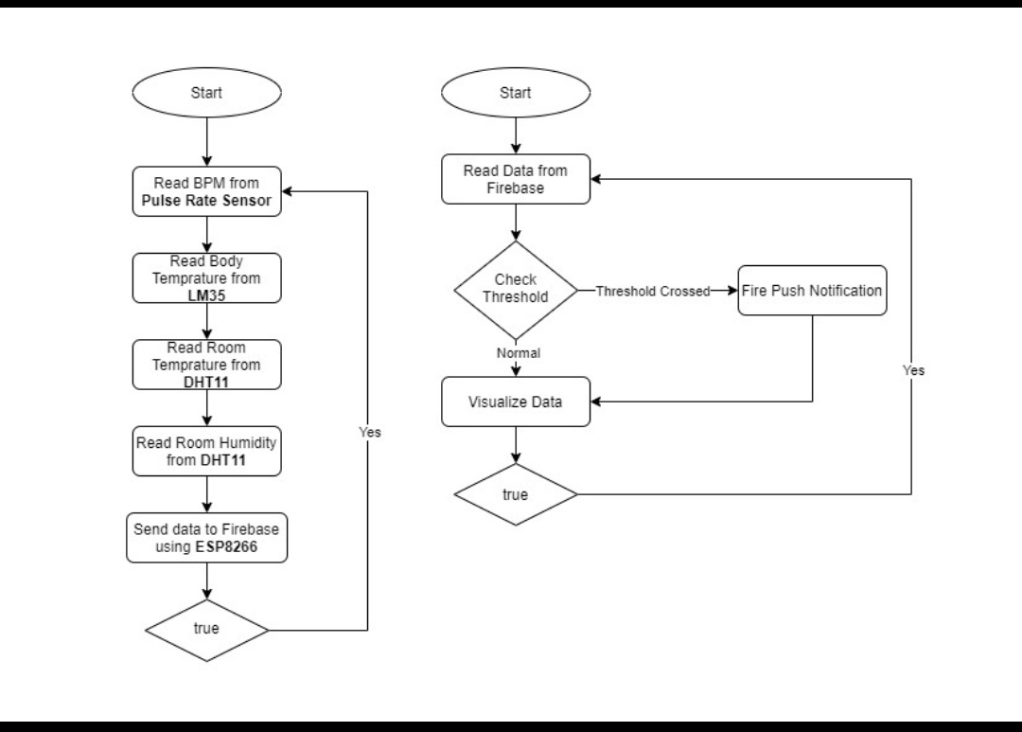
Workflow diagram

Slide 17
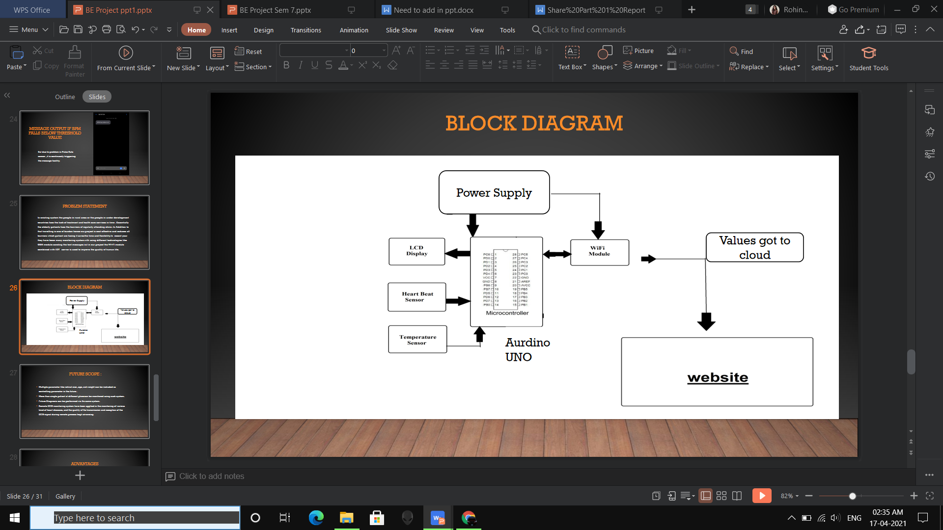
block diagram

Slide 18
Problem statement
In existing system the people in rural areas or the people in under development countries face the lack of treatment and health care services in time . Essentially the elderly patients face the barriers of regularly attending clinic .In Addition to that travelling is one of burden hence our project is cost effective and reduces all barriers which patient are facing it saves the time and flexibility.In recent year they have been many monitoring system with using different technologies like GSM module sending the text messages but in our project the WI-FI module combined with IOT server is used to improve the quality of human life.

Slide 19
Future scope :
Multiple parameter like retinal size ,age, and weight can be included as controlling parameter in the future .
More than single patient at different place can be monitored using such system.
Future Diagnosis can be performed via the same system.
Remote ECG monitoring system have been applied in the monitoring of various kind of heart diseases, and the quality of the transmission and reception of the ECG signal during remote process kept advancing.

Slide 20
Advantages
The patient can Monitor their health conditions at any time from any locations continuously and not required to visit hospital all the time.
The family members can also check patient’s health in an emergency situation.
The illness people are not required to stand in a long queue for doctors, thus save more time and cost.

Slide 21
Conclusion
The proposed system of patient health monitoring can be highly used in emergency situations as it can be daily monitored, recorded and stored as a database. In future the IOT device can be combined with the cloud computing so that the database can be shared in all the hospitals for the intensive care and treatment.

Slide 22
REFERENCES
IJTSRD_MAY-JUNE 2019_
IJITEE_APRIL 2019_
http://en.wikipedia.org /Wiki/Health Care Monitoring System
http://en.scientificcommons.org

Slide 23
THANK YOU

